Slide 1
Dynamic Routing Between Capsules
Sara Sabour, Nicholas Frosst, Geoffrey E. Hinton
Google Brain, NIPS 2017
Notes:
Explain capsule& routing, NN-> fixation-> parse tree

Slide 2
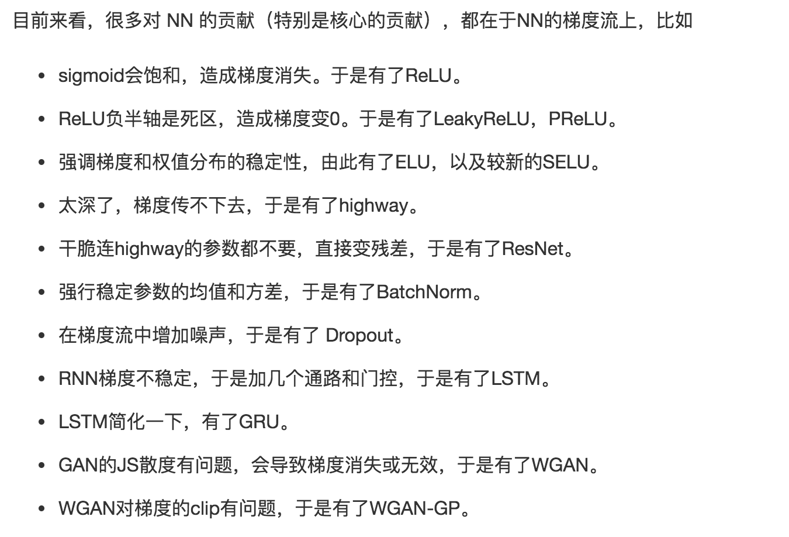
BP?
Notes:
1.有问题。 2.“人工优化”的影子

Slide 3
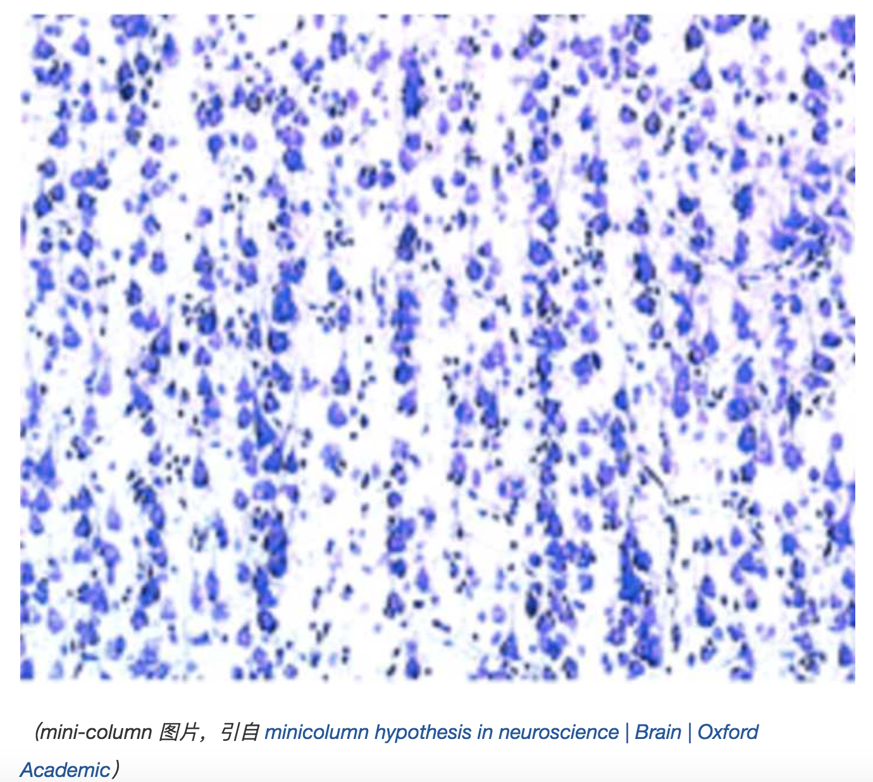
Mini-column
Notes:
神经解剖

Slide 4
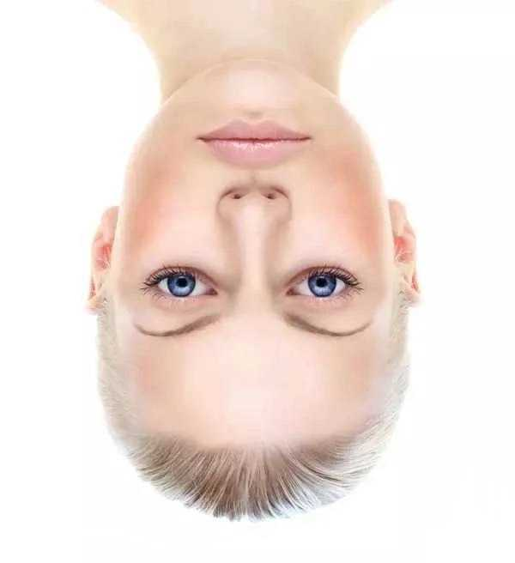
认知科学：先验知识
Notes:
认知科学， 先验知识：关键结构

Slide 5
认知科学：先验知识

Slide 6
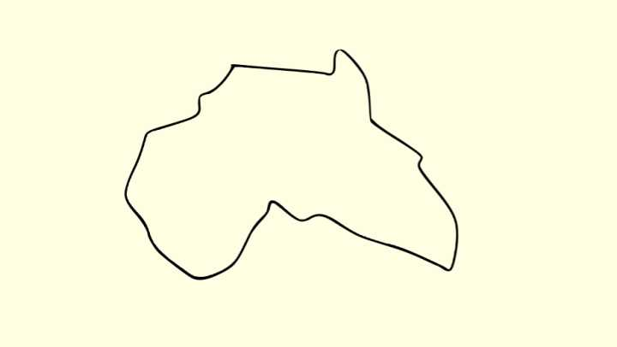
“坐标框架”
Notes:
坐标框架

Slide 7
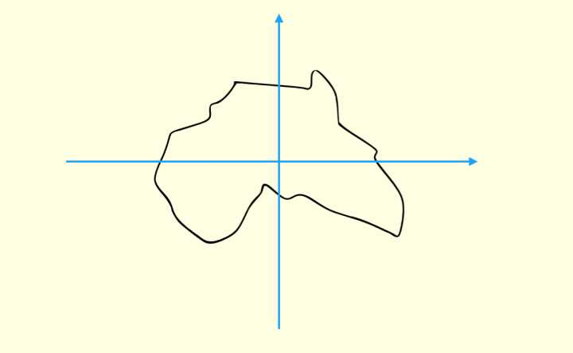
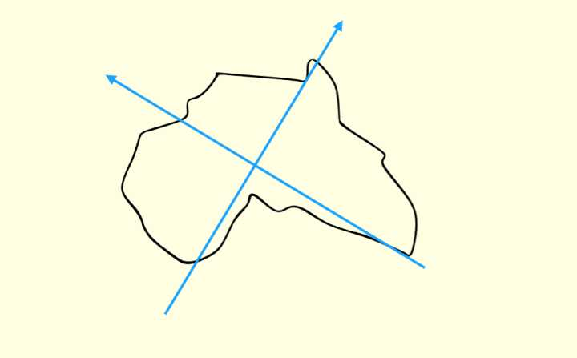
“坐标框架”

Slide 8
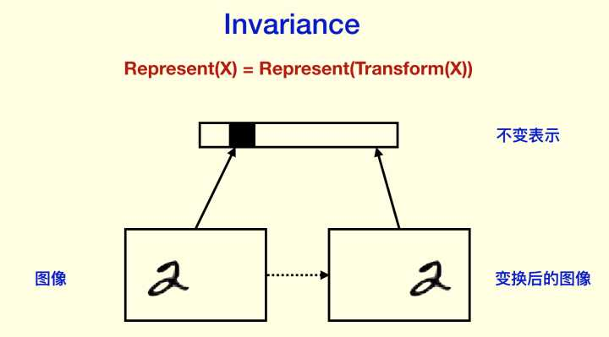
同变性（Equivariance）和不变性（Invariance）
Notes:
不变性和同变性

Slide 9
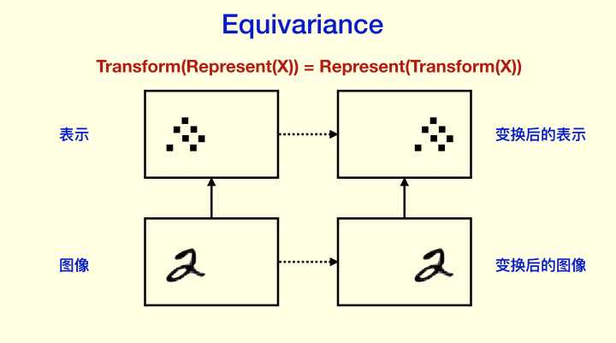
同变性（Equivariance）和不变性（Invariance）
Notes:
同变性：体现坐标框架的作用

Slide 10
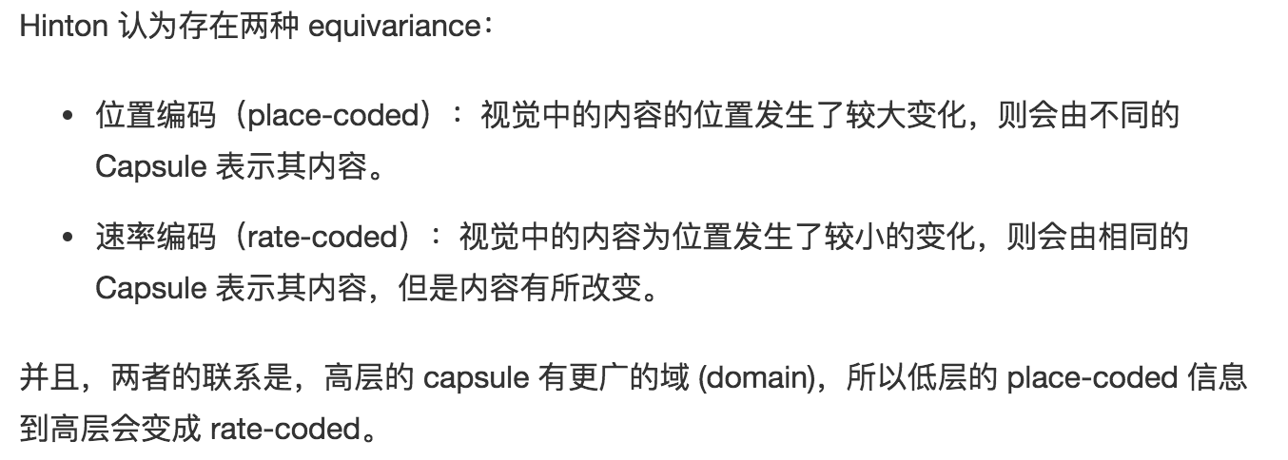
同变性（Equivariance）和不变性（Invariance）
Notes:
2种 。。。 从而用capsule更适合来表示

Slide 11
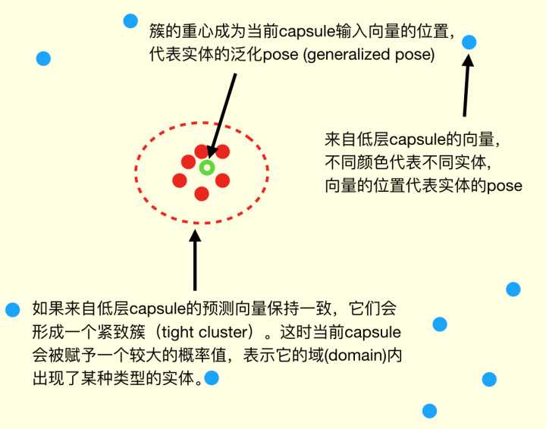
Capsule 与 coincidence filtering （巧合筛分）

Slide 12
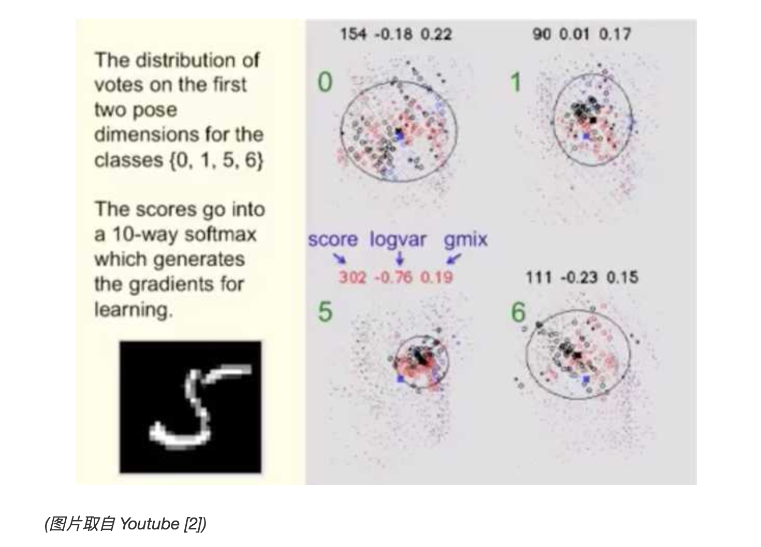
Capsule 与 coincidence filtering （巧合筛分）

Slide 13
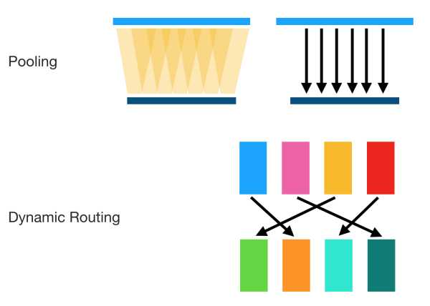
Capsule 与 coincidence filtering （巧合筛分）

Slide 14
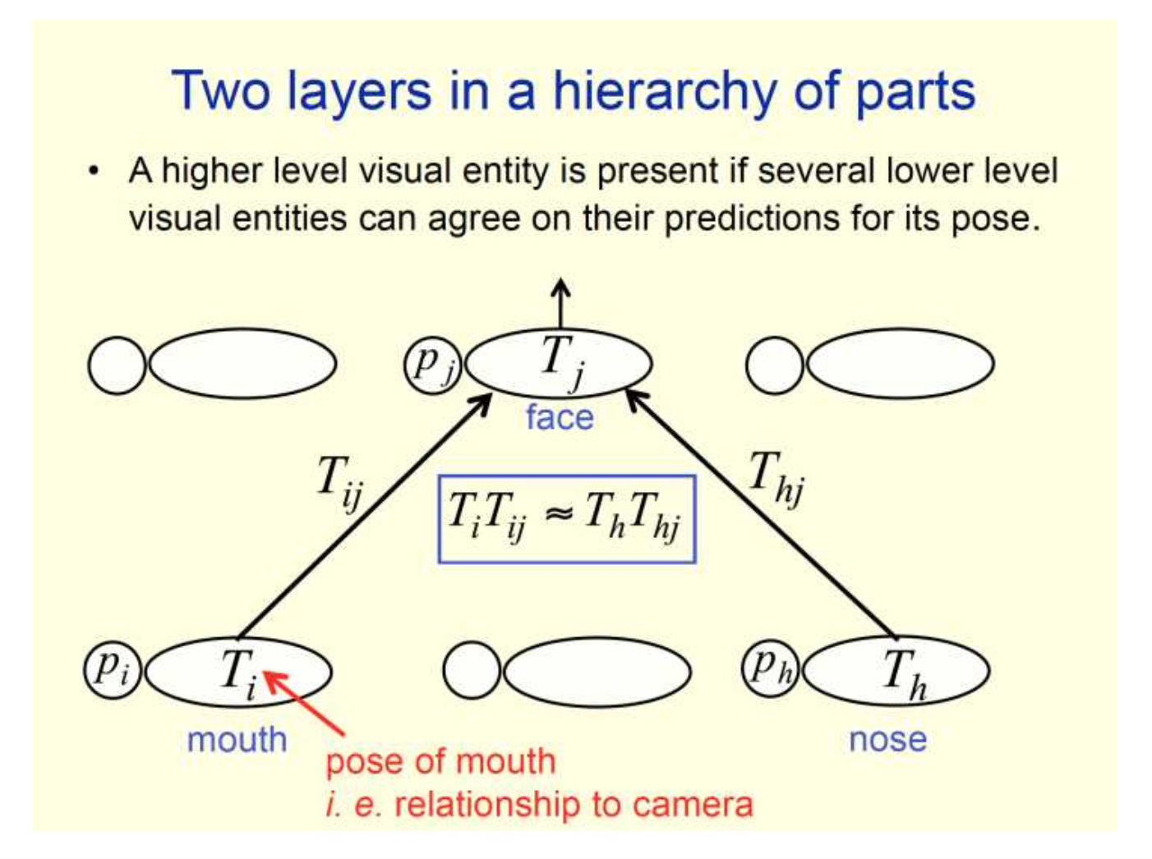
图形学和线性流形（linear manifold）

Slide 15
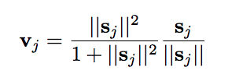
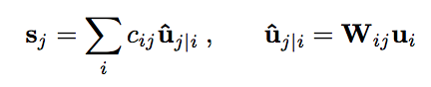
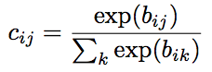
vector inputs and outputs of a capsule
Squashing
Attention

Slide 16
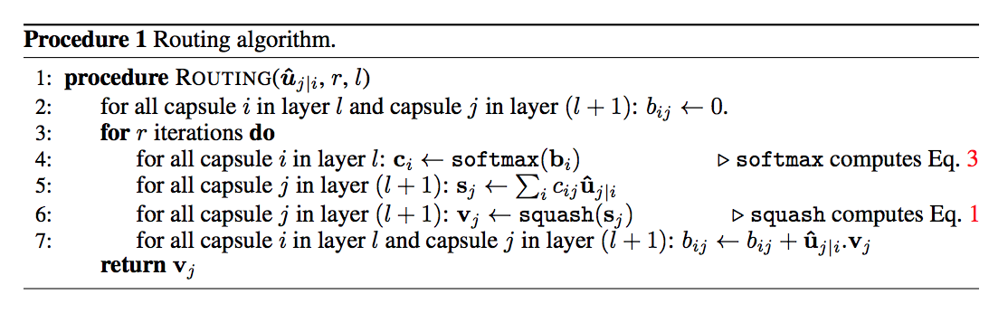
vector inputs and outputs of a capsule

Slide 17
Margin loss for digit existence
To allow for multiple digits, we use a separate margin loss, L_{k} for each digit capsule, k:
where T_{c} = 1 iff a digit of class c is present and m⁺ = 0.9 and m⁻ = 0.1.

Slide 18
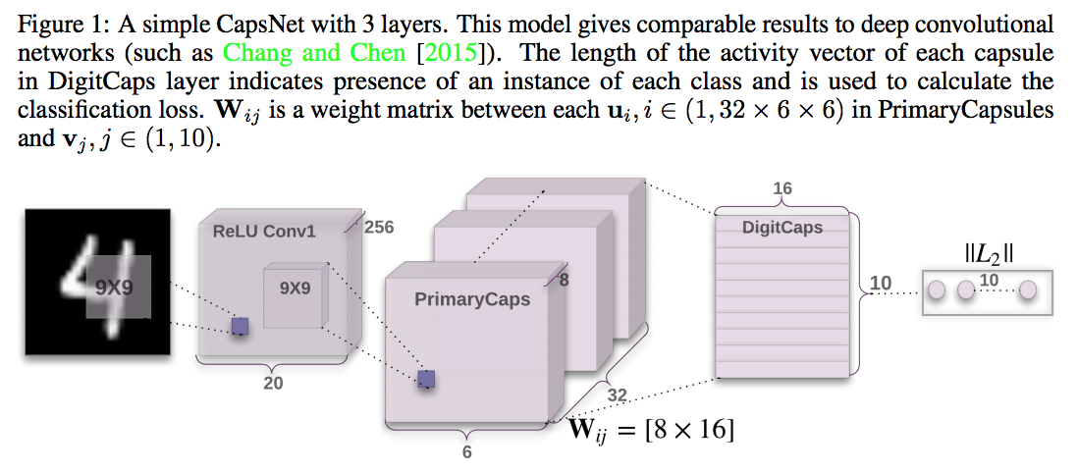
CapsNet architecture

Slide 19
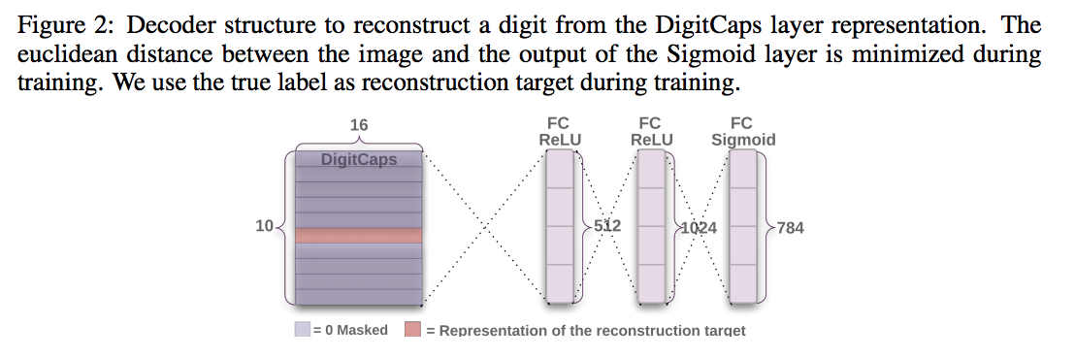
Reconstruction as a regularization method

Slide 20
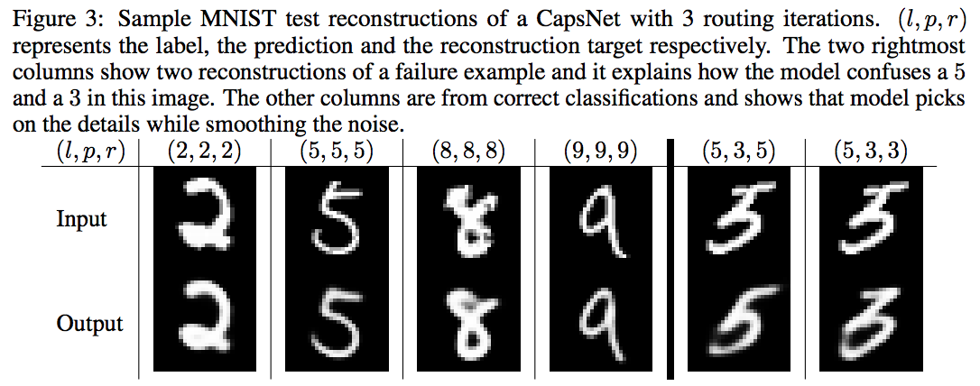
Capsules on MNIST

Slide 21
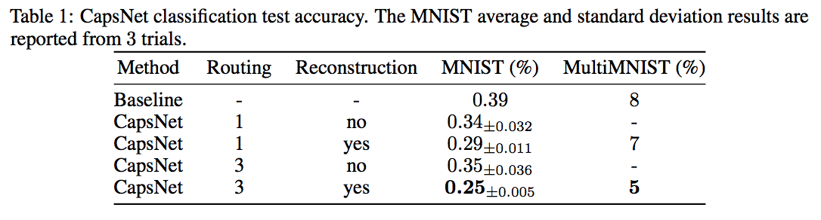
Capsules on MNIST

Slide 22
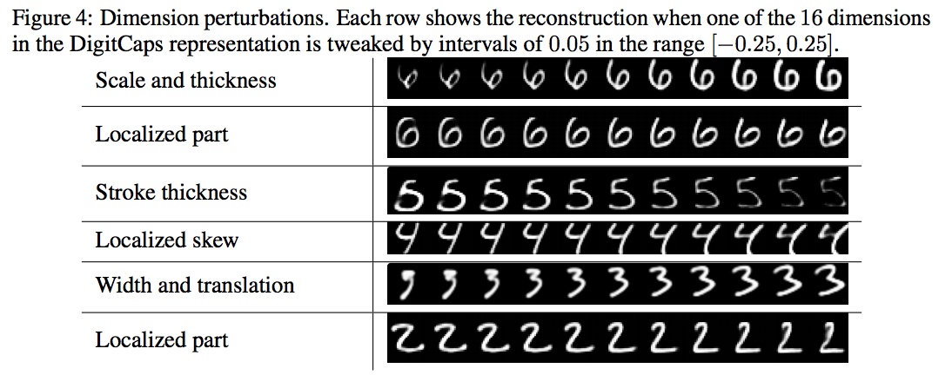
What the individual dimensions of a capsule represent

Slide 23
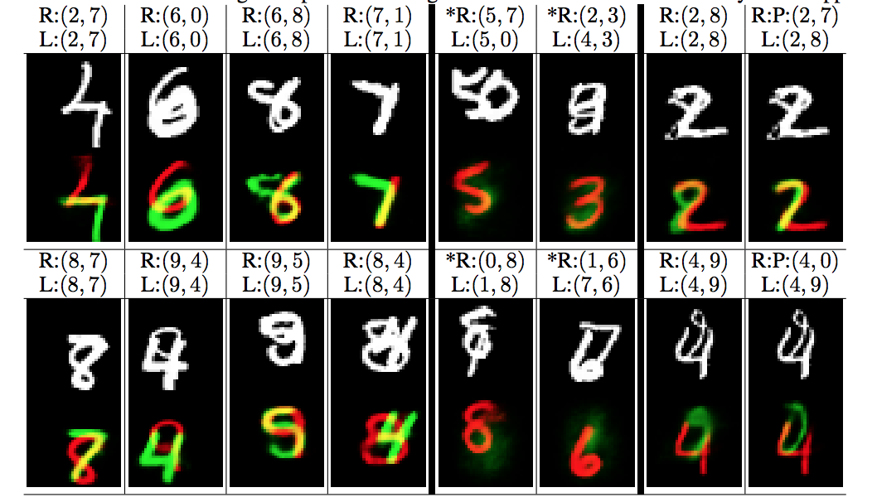
Segmenting highly overlapping digits

Slide 24
MATRIX CAPSULES WITH EM ROUTING
Anonymous authors
Under review as a conference paper at ICLR 2018

Slide 25
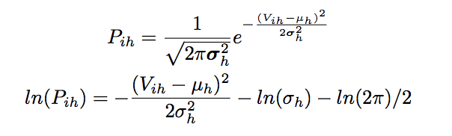
USING EM FOR ROUTING-BY-AGREEMENT
the capsule’s Gaussian model

Slide 26
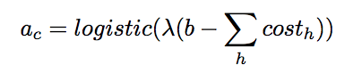
USING EM FOR ROUTING-BY-AGREEMENT
Summing over all lower-level capsules for a single dimension of one higher-level capsule：
the activation function of capsules c

Slide 27
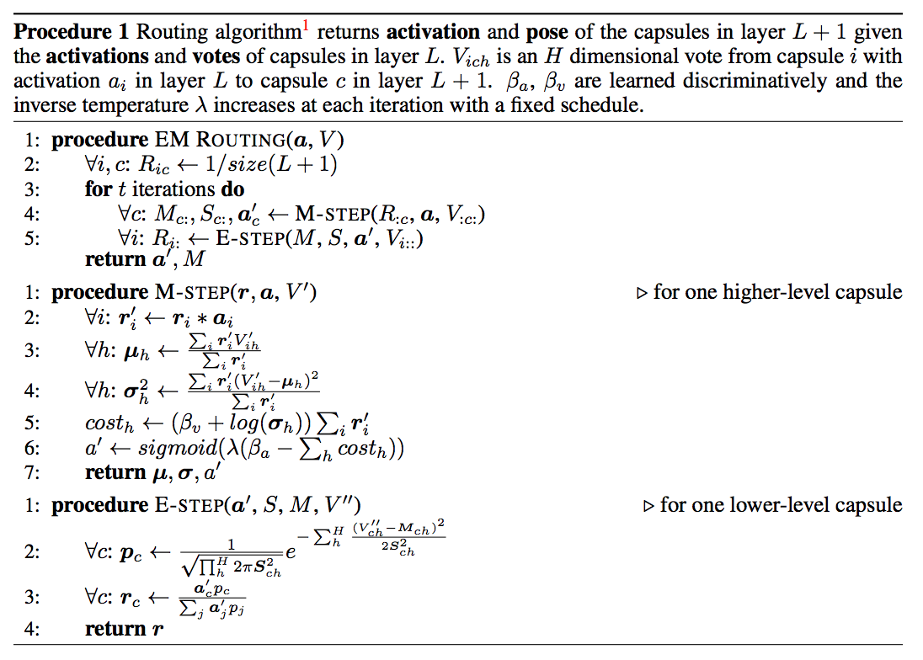
USING EM FOR ROUTING-BY-AGREEMENT

Slide 28
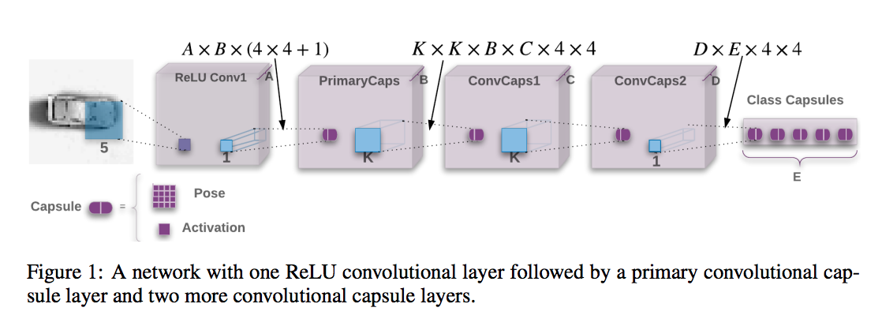
THE CAPSULES MODEL

Slide 29
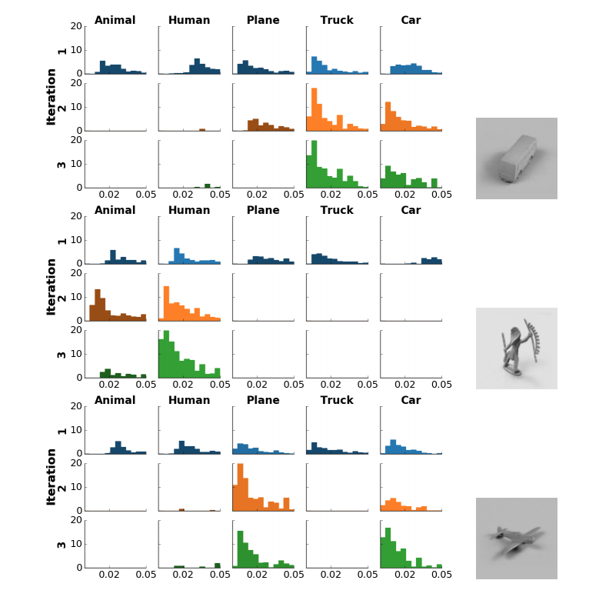
EXPERIMENTS

Slide 30
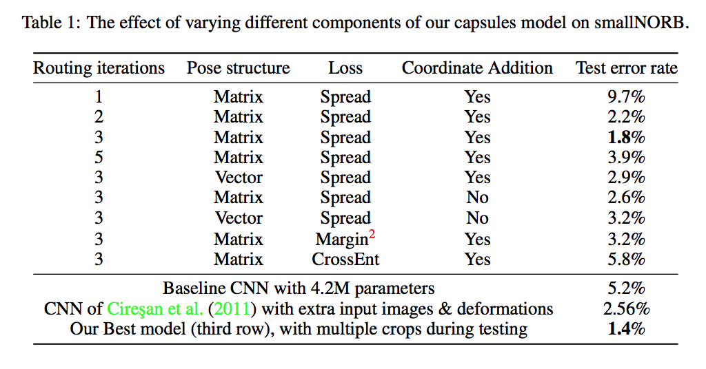
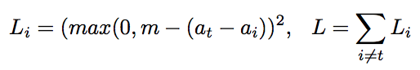
EXPERIMENTS
Spread loss:

Slide 31
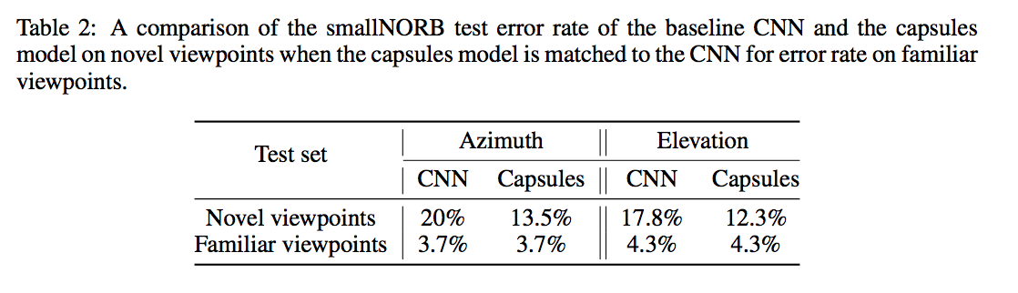
EXPERIMENTS
Notes:
GENERALIZATION TO NOVEL VIEWPOINTS

Slide 32
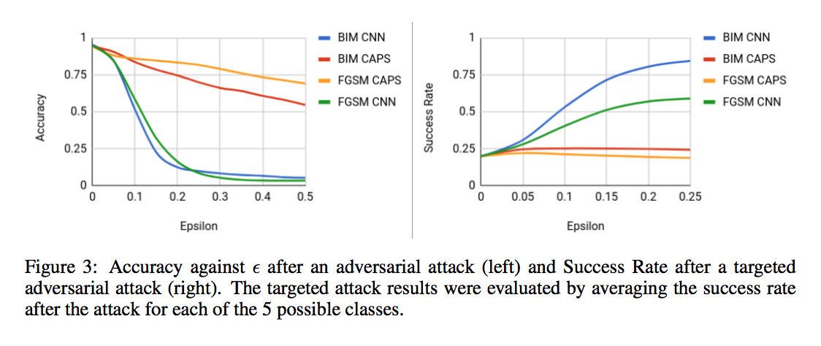
EXPERIMENTS
Notes:
对抗白盒攻击

Slide 33
Thank you

